Slide 2
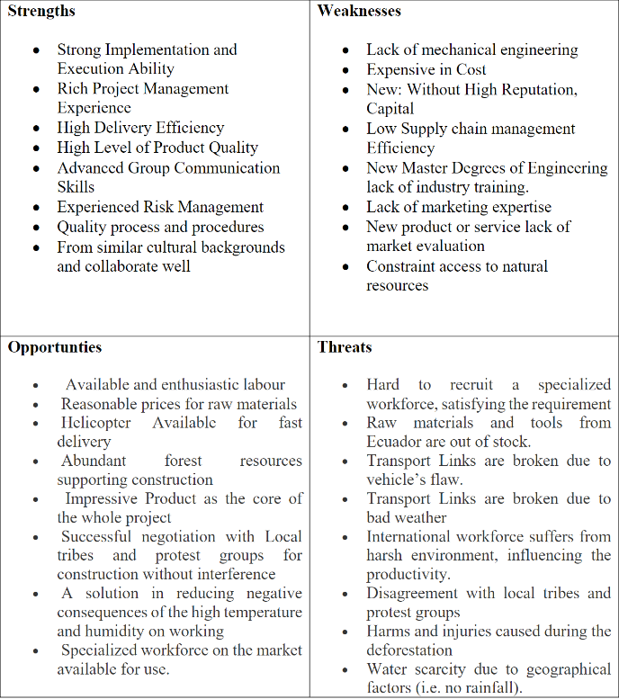

Task 1
Notes:
Situation and Task

Slide 3
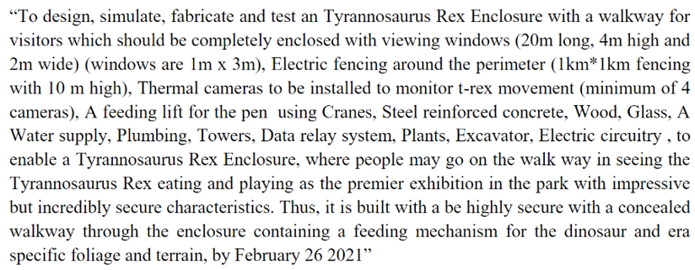
Task 1: Smart Objectives

Slide 4
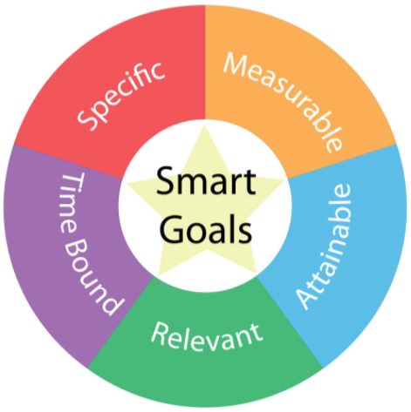
Task 1 Smart Objectives STAR Analysis
Situation
  Tyrannosaurus Rex Enclosure project
  Project planning
Task
  Specific
  Measurable
  Achievable
  Relevant
  Time limited
Action
  Specific numbers
  Clear definitions to the available adjective
  Realistic considerations
Result
  “Excellent” feedback on Engineering projects.

